Slide 1
Predictive Analytics
Introduction. Time series analysis

Slide 2

Types of Analytics
Descriptive Analytics – What has happened?
Predictive Analytics – What might happen?
Prescriptive Analytics – What should we do?

Slide 3
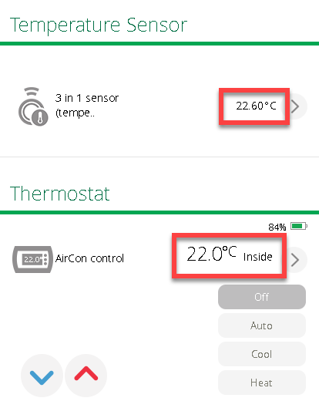
Predictive analytics
Present VS Future
Prediction VS Estimation
Questions to answer:
Will a person buy a house? – Yes or no.
How much will he pay for a house? – Amount of dollars.
When will he buy a house? – A date.
How long will he keep looking for a house? – Length of time period.

Slide 4
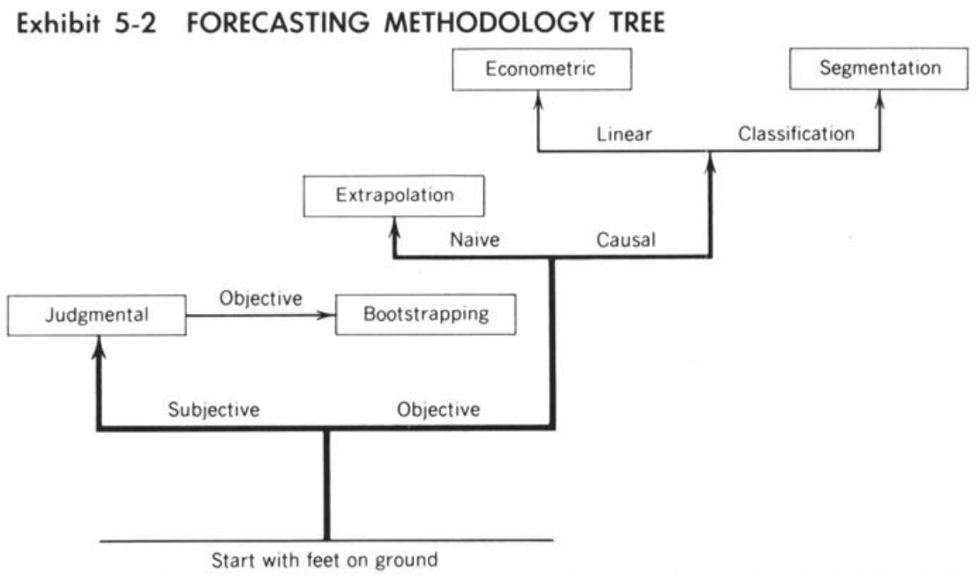
Types of Predictive analytics
Objective methods:
Causal models
Time series
Artificial Intelligence (AI)
Subjective methods:
Composites
Surveys
Jury of executive opinions
The Delphi method
Prediction or information markets
Combined Methods
ARMSTRONC, J. S. (1985). Long-Range Forecasting: From Cristal Ball to Computer (2nd Edn). New York: Wiley-Interscience.

Slide 5
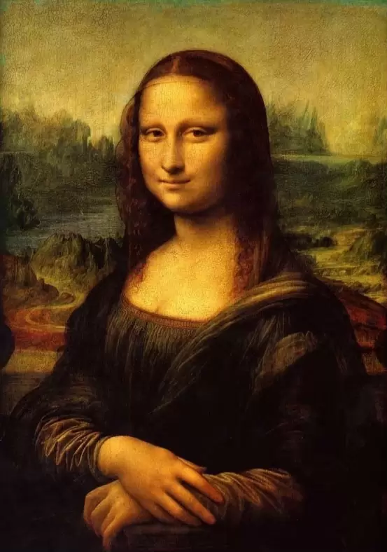

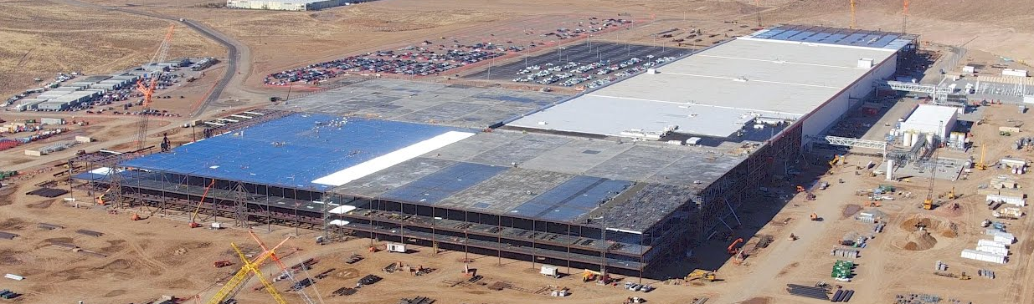
Subjective forecasting
What is a likelihood of a nuclear war?
Should Tesla build new Gigafactory in Shanghai?
What is price of Mona Lisa by Leonardo da Vinci?

Slide 6

Subjective forecasting
2007 – Should Apple release the very first smartphone?
Apple iPhone 1Gen

Slide 7
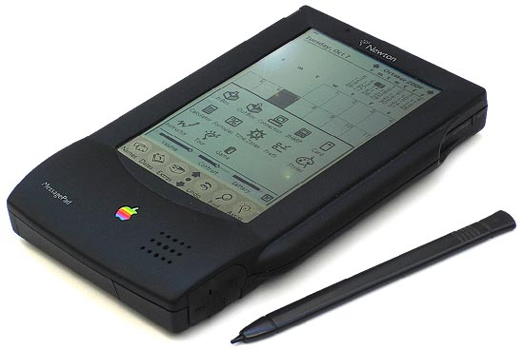
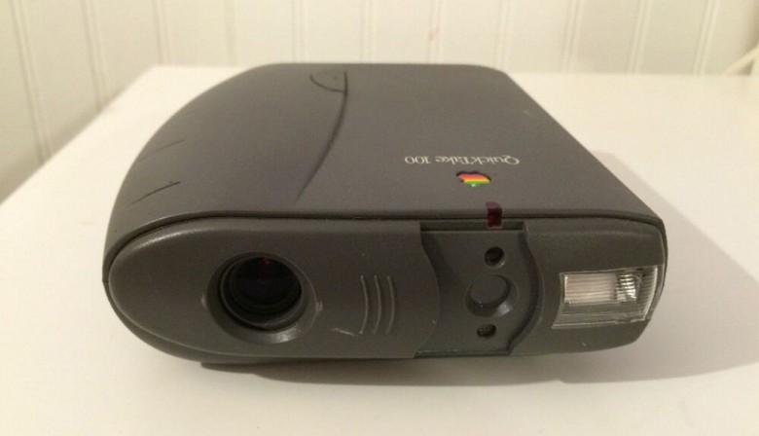
Subjective forecasting
2007 – Should Apple release the very first smartphone?
1993 – Should Apple release the very first tablet?
1994 – Should Apple release the very first digital camera?
Apple iPhone 1Gen
Apple Newton
Apple QuickTake 100

Slide 8
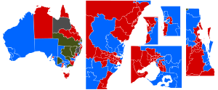
Subjective forecasting
Qualitative methods
Also called: implicit, informal, clinical, experienced-based, intuitive methods, guesstimates, WAGs (wild-assed guesses), or gut feelings.
Aggregation of expert opinions:
Sales Force Composites – aggregation of sales personnel estimates
Jury of executive opinions
Surveys – customer surveys, political elections polls

Slide 9

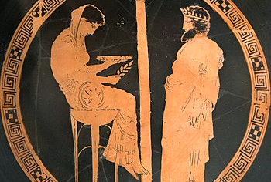
The Delphi Method
Interactive forecasting method which relies on a panel of experts
The Delphi method is based on the assumption that group judgments are more valid than individual judgments
Key characteristics:
anonymity of participants;
structuring of information flow;
regular feedback;
role of the facilitator.

Slide 10

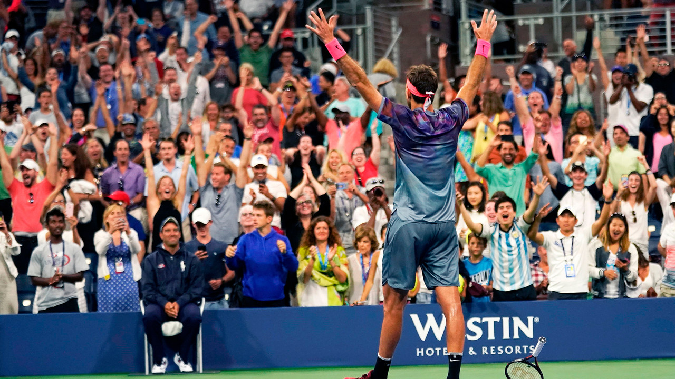
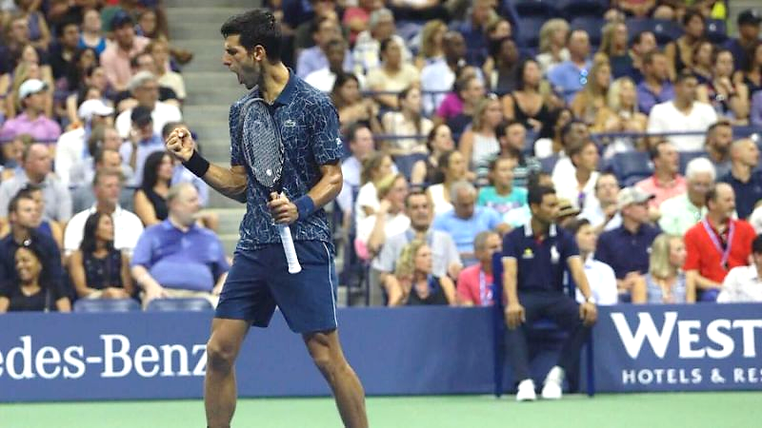
Big Tennis

Slide 11
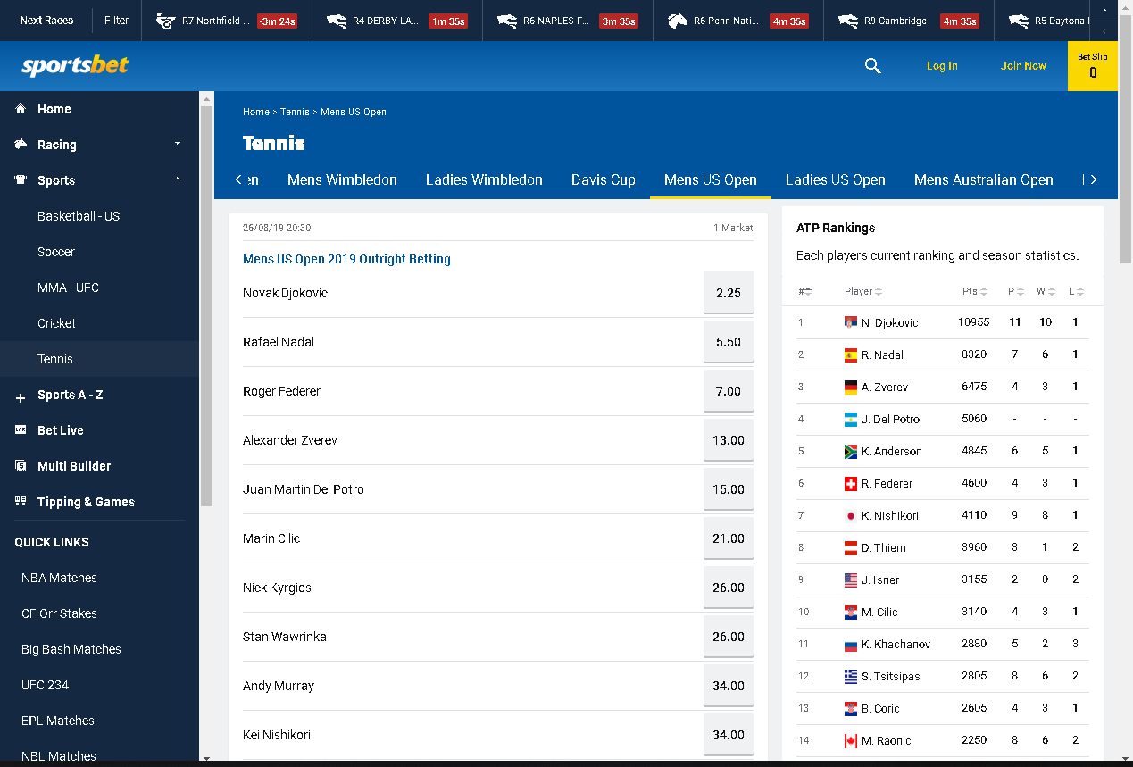
Information markets
Put your money where your mouth is!

Slide 12
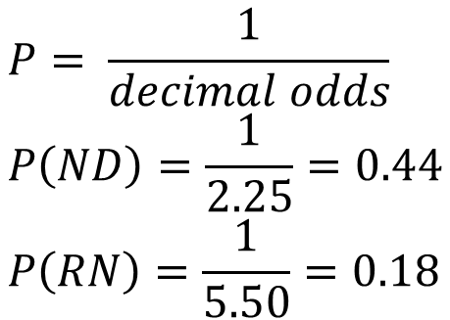
Information markets
Implied probability
$$P= \frac{1}{decimal odds} \\ P\left(ND\right)=\frac{1}{2.25}=0.44 \\ P\left(RN\right)=\frac{1}{5.50}=0.18$$
Put your money where your mouth is!

Slide 13
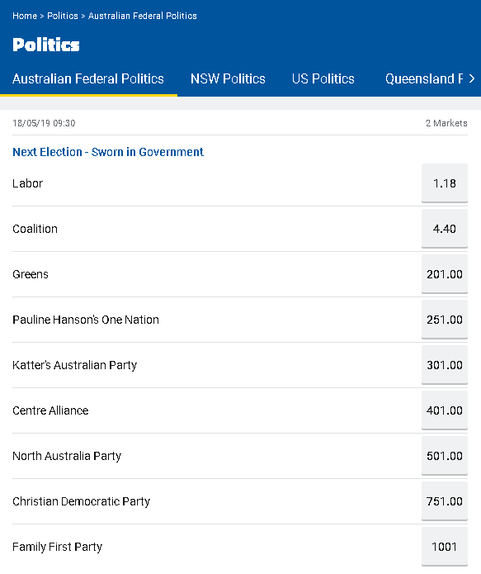
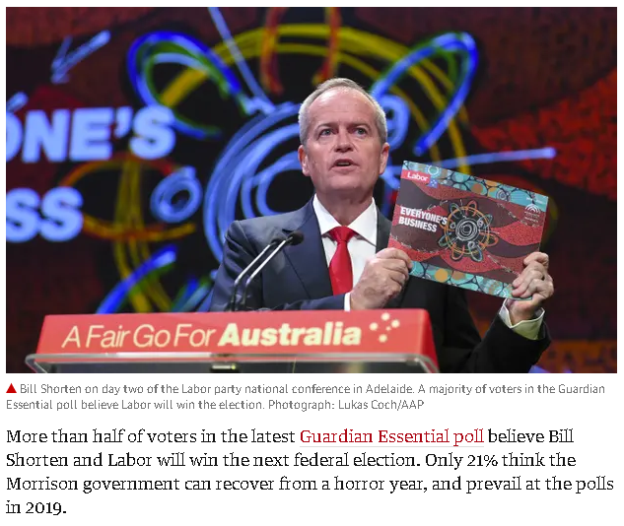
Information markets

Slide 14

Information markets
https://www.cia.gov/library/center-for-the-study-of-intelligence/csi-publications/csi-studies/studies/vol50no4/using-prediction-markets-to-enhance-us-intelligence-capabilities.html

Slide 15

Combined methods
Increase a number of experts
Take implicit subjective method and make it explicit and operational
Right down rules used by experts to make their decisions and then use bootstrapping to create a huge number of opinions and converge to some decision
There is safety in numbers
George Bernard Shaw is reported to have received in the mail a proposal for marriage in which a lady said, "With my beauty and your brains we could have the perfect child." Shaw replied, "But what if the child had my looks and your brains?"

Slide 16
Objective forecasting
Based on abundance of data and objective (statistical) methods of data analysis
Causal models: regression and classification models
Time series analysis: trend, seasonality, moving averages, smoothing, …
Artificial Intelligence (AI): Neural networks, Machine Learning, Deep Learning
Business questions:
What would be sales next month?
Will the client renew subscription?
Should the customer be given a home loan?
What is a probability of a customer to default?
What is weather forecast for tomorrow, next week, next season?

Slide 17
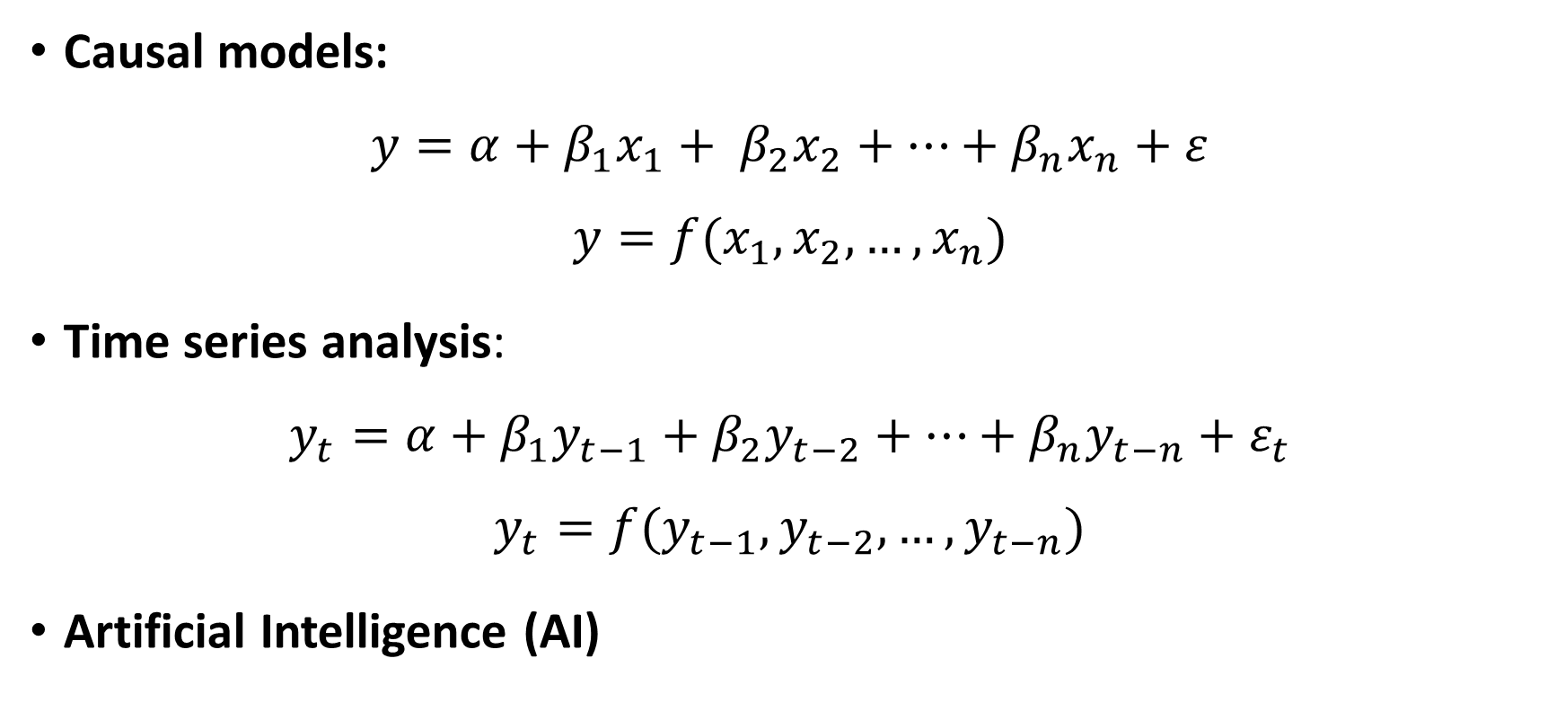
Objective forecasting
Causal models:
$$y=α+β_{1}x_{1}+ β_{2}x_{2}+…+β_{n}x_{n}+ε$$
$$y=f(x_{1},x_{2},…,x_{n})$$
Time series analysis:
$$y_{t}=α+β_{1}y_{t−1}+β_{2}y_{t−2}+…+β_{n}y_{t−n}+ε_{t}$$
$$y_{t}=f(y_{t−1},y_{t−2},…,y_{t−n})$$
Artificial Intelligence (AI)

Slide 18
ARMSTRONC, J. S. (1985). Long-Range Forecasting: From Cristal Ball to Computer (2nd Edn). New York: Wiley-Interscience.

Slide 19
Time series - Trend
Google search for “Data Science”- weekly data
https://trends.google.com/trends/explore?date=today%205-y&geo=US&q=Data%20science

Slide 20
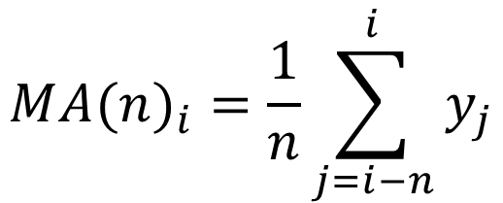
Time series – Moving average
Google search for “Data Science”- weekly data
$$M{A(n)}_{i}=\frac{1}{n}\sum_{j=i−n}^{i}{y_{j}}$$
https://trends.google.com/trends/explore?date=today%205-y&geo=US&q=Data%20science

Slide 21
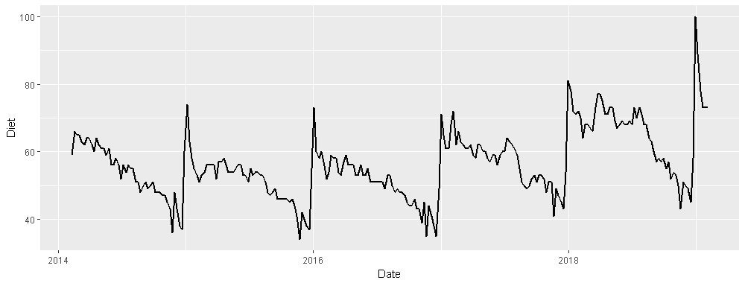
Time series - Seasonality
invisible(lapply(c("readr", "dplyr", "ggplot2", "tseries"), library, character.only = TRUE))
diet <- read_csv("Diet.csv")
diet <- diet %>% mutate(Date = as.Date(Week, format="%d-%m-%y"), Type="Real") %>% select(-Week)
ggplot(data=diet, aes(x=Date, y=Diet)) + geom_line(size=1)
Google search for word “Diet”- weekly data
https://trends.google.com/trends/explore?date=today%205-y&geo=US&q=Diet

Slide 22
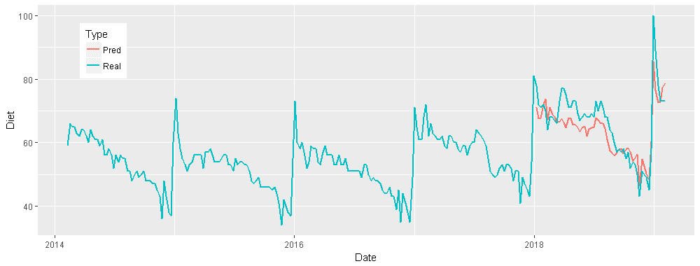
Time series - Seasonality
fit <- arima(diet$Diet[1:204], c(0, 1, 1), seasonal = list(order = c(0, 1, 1), period = 52))
pred <- predict(fit, n.ahead = 57)
diet2 <- rbind(diet, data.frame(Date=diet$Date[205:261], Diet=pred$pred, Type="Pred"))
ggplot(data=diet2, aes(x=Date, y=Diet, group=Type)) + geom_line(aes(color=Type), size=1) + theme(legend.position = c(0.1, 0.8))
Google search for word “Diet”- weekly data
https://trends.google.com/trends/explore?date=today%205-y&geo=US&q=Diet

Slide 23
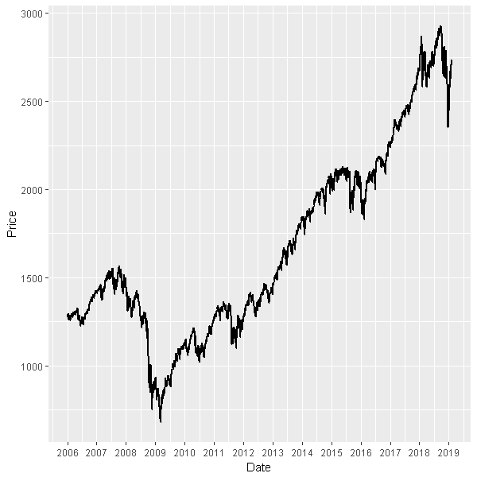
Stock market
> invisible(lapply(c("readr", "dplyr", "ggplot2"),
library, character.only = TRUE))
> spx <- read_csv("SP 500 Historical Data.csv")
> spx$Date <- as.Date(spx$Date, format="%b %d, %Y")
> head(spx)
# A tibble: 6 x 7
Date Price Open High Low ...
<date> <dbl> <dbl> <dbl> <dbl>
1 2019-02-07 2706.05 2717.53 2719.32 2687.26
2 2019-02-06 2731.61 2735.05 2738.08 2724.15
3 2019-02-05 2737.70 2728.34 2738.98 2724.03
4 2019-02-04 2724.87 2706.49 2724.99 2698.75
5 2019-02-01 2706.53 2702.32 2716.66 2696.88
6 2019-01-31 2704.10 2685.49 2708.95 2678.65
> ggplot(data=spx, aes(x=Date, y=Price)) +
geom_line(size=1) +
scale_x_date(date_breaks = "1 year",
date_labels = "%Y")

Slide 24
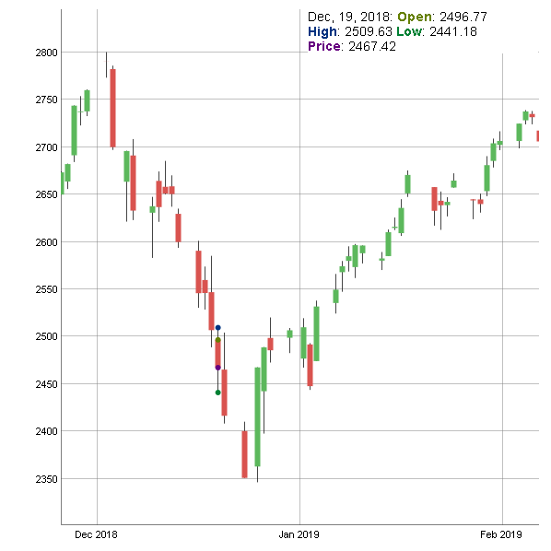
Stock market
> spx2 <- as.matrix( spx[, c("Open","High","Low","Price")])
> rownames(spx2) <- as.character(spx$Date)
>
> library(dygraphs)
> dygraph(head(spx2, 50)) %>% dyCandlestick()
> head(spx2)
Open High Low Price
2019-02-07 2717.53 2719.32 2687.26 2706.05
2019-02-06 2735.05 2738.08 2724.15 2731.61
2019-02-05 2728.34 2738.98 2724.03 2737.70
2019-02-04 2706.49 2724.99 2698.75 2724.87
2019-02-01 2702.32 2716.66 2696.88 2706.53
2019-01-31 2685.49 2708.95 2678.65 2704.10

Slide 25
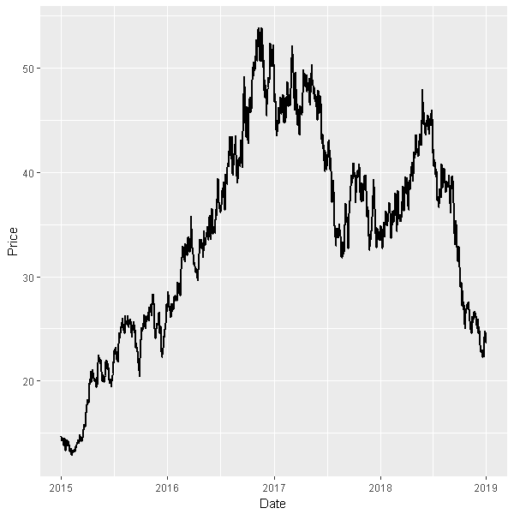
Stock market

Slide 26
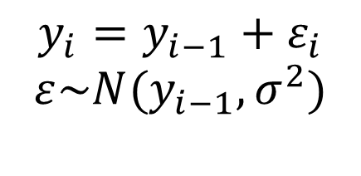
Random Walk
> x <- data.frame(Date=seq.Date(as.Date("2015/1/1"), as.Date("2019/1/1"), by = "day"))
> x$Change <- rnorm(nrow(x), mean=0.0, sd=0.02)
> x$Price <- cumprod(x$Change + 1) * 15
> ggplot(data=x, aes(x=Date, y=Price)) + geom_line(size=1) + scale_x_date(date_breaks = "1 year", date_labels = "%Y")
> head(x)
Date Change Price
1 2015-01-01 -0.019639236 14.70541
2 2015-01-02 -0.032072142 14.23378
3 2015-01-03 0.005396977 14.31060
4 2015-01-04 0.008209022 14.42807
5 2015-01-05 0.007262849 14.53286
6 2015-01-06 -0.008218076 14.41343
$$y_{i}=y_{i−1}+ε_{i}$$
$$ε\sim N(y_{i−1}, σ^{2})$$

Slide 27
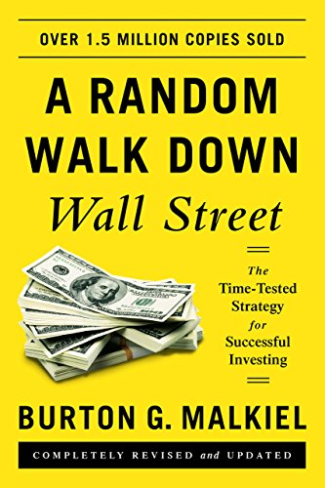

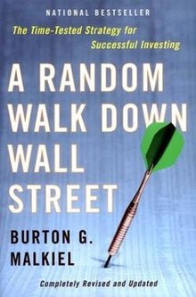
Random Walk

Slide 28
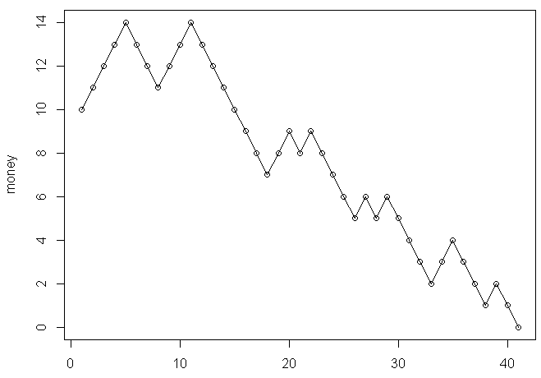
Gambler’s ruin problem
money <- 10
cnt <- 1
while(money[cnt] > 0){
new_game <- sample(c(-1,1), size=1,
prob=c(0.5, 0.5))
money <- c(money, money[cnt] + new_game)
cnt <- cnt + 1
}
print(cnt)
[1] 41
http://web.mit.edu/neboat/Public/6.042/randomwalks.pdf
Gambler starts with some money
‘Fair game’ with 50:50 chance
Result of each game is up or down $1
For how long will the player play?
How much money will he get?

Slide 29
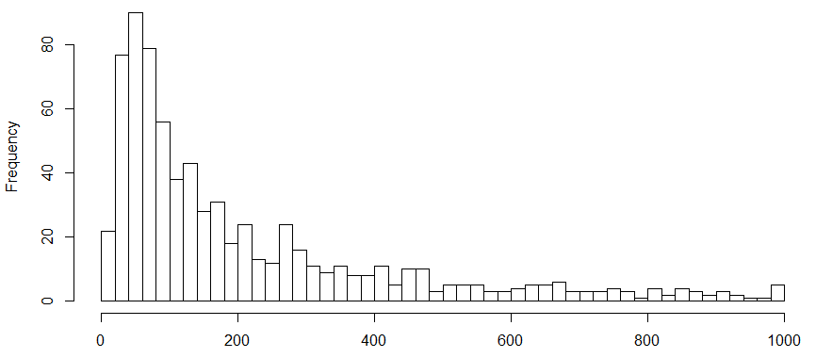
Gambler’s ruin problem
library(doSNOW); library(foreach)
cl <- makeCluster(6, type="SOCK"); registerDoSNOW(cl)
res <- foreach(i=seq(1,1000), .combine=c) %dopar% {
money <- 10; cnt <- 1
while(money > 0){
new_game <- sample(c(-1,1), size=1, prob=c(0.5, 0.5))
money <- money + new_game
cnt <- cnt + 1
if(cnt > 1000){
break
}
}
cnt
}
hist(res[res < 1000], breaks=50)

Slide 30

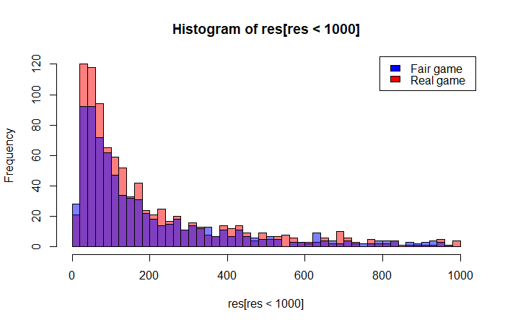
Gambler’s ruin problem
library(doSNOW); library(foreach)
cl <- makeCluster(6, type="SOCK"); registerDoSNOW(cl)
res <- foreach(i=seq(1,1000), .combine=c) %dopar% {
money <- 10; cnt <- 1
while(money > 0){
new_game <- sample(c(-1,1), size=1, prob=c(19/37, 18/37))
money <- money + new_game
cnt <- cnt + 1
if(cnt > 1000){
break
}
}
cnt
}
hist(res[res < 1000], breaks=50)

Slide 31
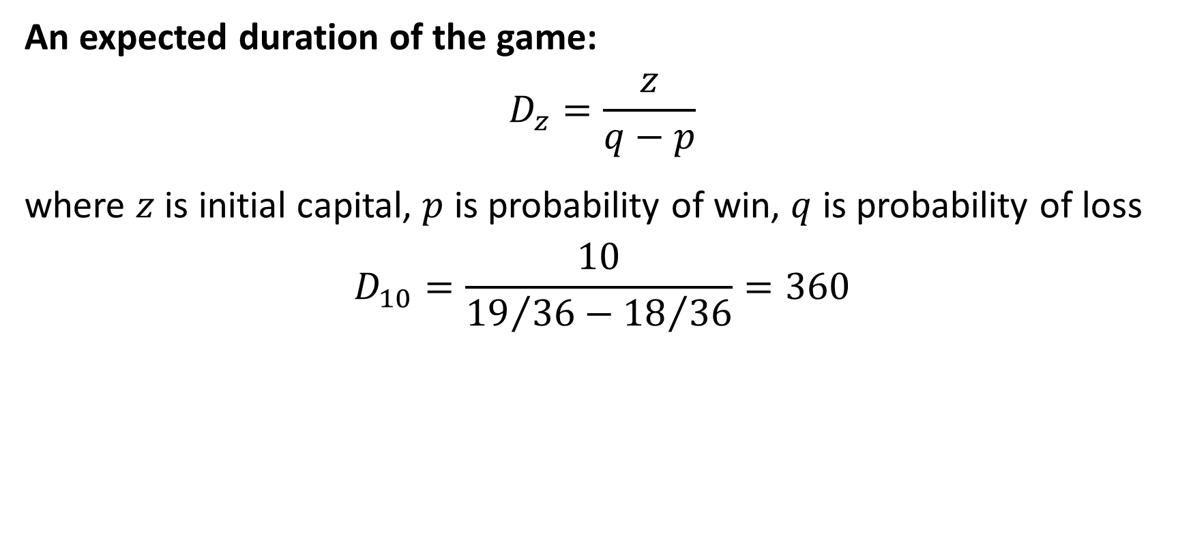
Gambler’s ruin problem
An expected duration of the game:
$$D_{z}=\frac{z}{q−p}$$
where $z$ is initial capital, $p$ is probability of win, $q$ is probability of loss
$$D_{10}=\frac{10}{{19}/{36}−{18}/{36}}=360$$

Slide 32
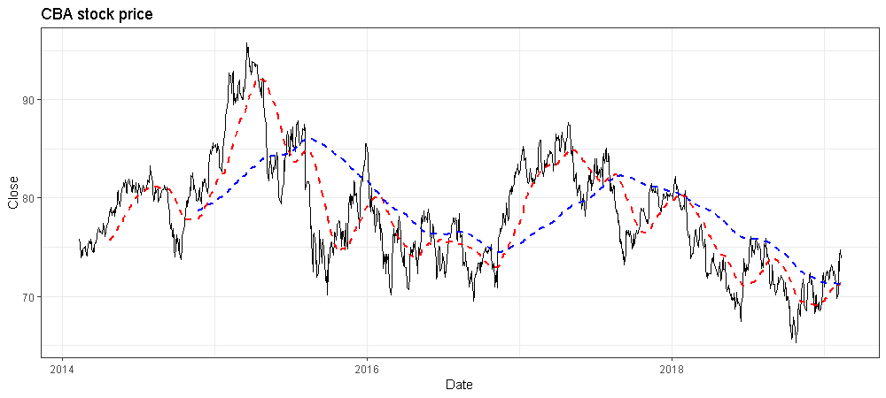
Trading strategies
library(readr)
library(tidyquant)
bank <- read_csv("CBA.AX.csv")
ggplot(data=bank, aes(x=Date, y=Close)) +
geom_line(size=0.5) + theme_bw() +
ggtitle("CBA stock price") +
geom_ma(ma_fun=SMA, n=50, color="red", size=1) +
geom_ma(ma_fun=SMA, n=200, color="blue", size=1)

Slide 33
Momentum vs Contrarian strategies

Slide 34
Trading strategies

Slide 35
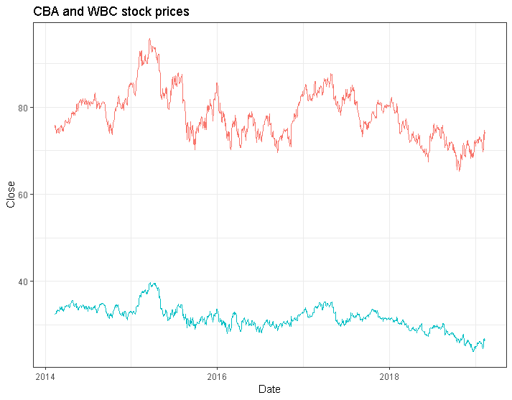
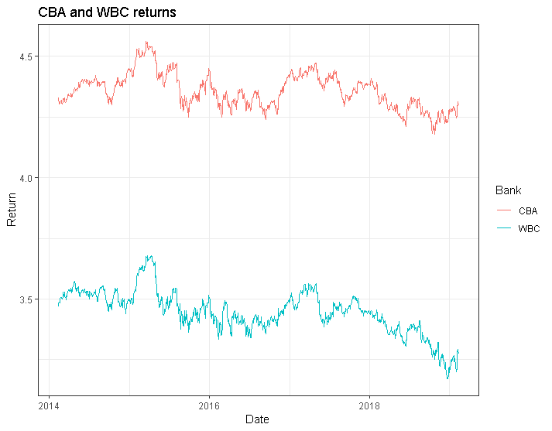
Finance engineering – log transformation

Slide 36
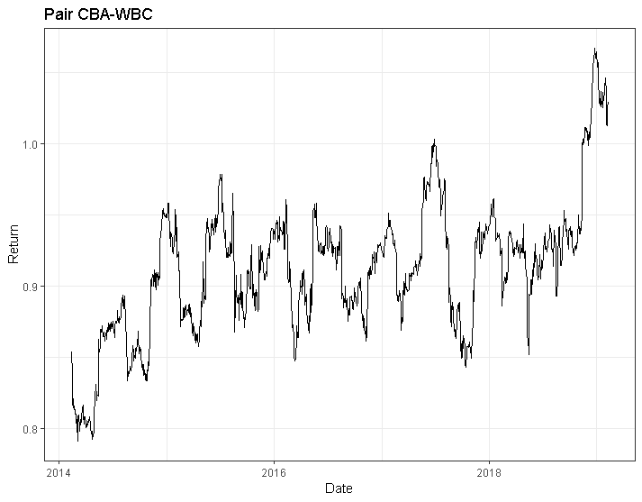
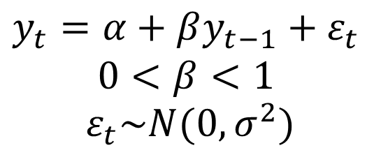
Finance engineering – synthetic asset
library(readr); library(tidyquant)
CBA <- read_csv("CBA.AX.csv")
WBC <- read_csv("WBC.AX.csv")
pair <- data.frame(Date=CBA$Date,
Return=log(CBA$Close) - log(WBC$Close))
ggplot(data=pair, aes(x=Date, y=Return)) +
geom_line(size=0.5) + theme_bw() +
ggtitle("Pair CBA-WBC")
$$y_{t}=α+βy_{t−1}+ε_{t}$$
$$0<β<1$$
$$ε_{t}\sim N(0,σ^{2})$$

Slide 37
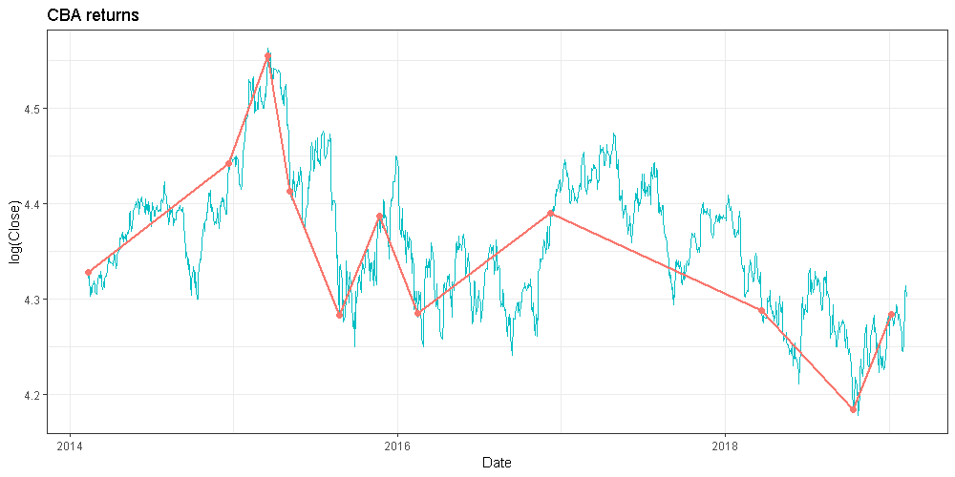
Time series filtering

Slide 38
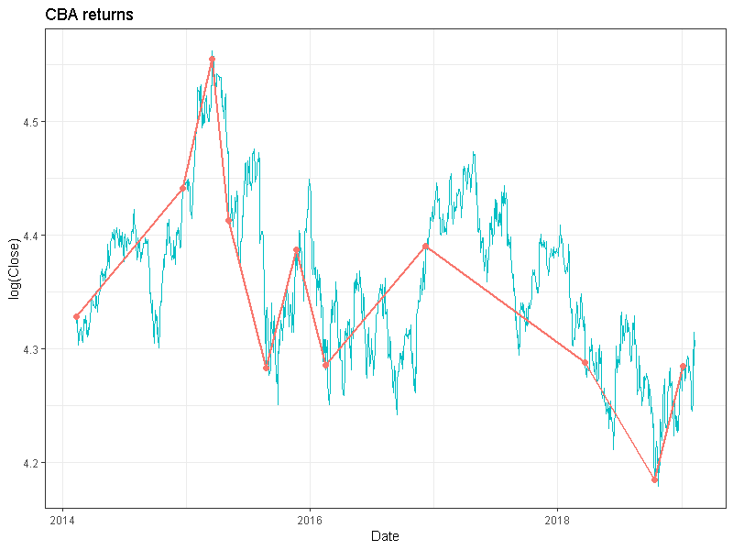
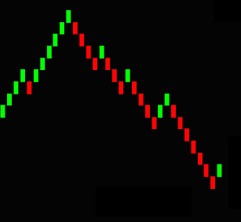
Time series filtering
library(readr); library(dplyr)
CBA <- read_csv("CBA.AX.csv")
renko <- function(pr, H){
res <- data.frame(Time=1, Return=pr[1])
for(i in seq(2, length(pr))){
if(abs(pr[tail(res$Time,1)] - pr[i]) >= H){
res <- res %>% add_row(Time=i, Return=pr[i])
}
}
return(res)
}
ren <- renko(log(CBA$Close), H=0.1)
ren$Date <- CBA$Date[ren$Time]
ggplot(data=CBA, aes(x=Date, y=log(Close))) + geom_line(size=0.5, col="#00BFC4") + theme_bw() + ggtitle("CBA returns") + geom_line(data=ren, aes(x=Date, y=Return), size=1, col="#F8766D") + geom_point(data=ren, aes(x=Date, y=Return), size=2, col="#F8766D")

Slide 39
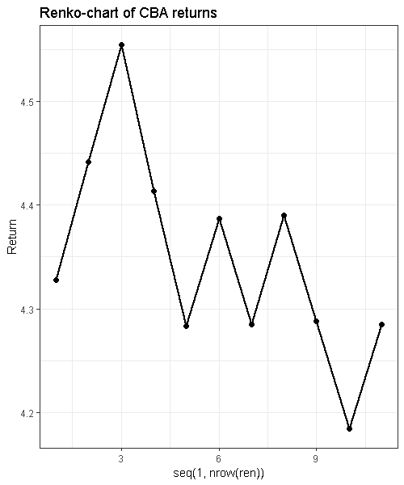
Time series filtering

Slide 40
Time series filtering
$10,000 * 0.9 * 1.1 * 0.9 * 1.1 * 1.1 * 1.1 * 1.1 * 0.9 * 1.1 = $12,914 or 5.2% per year

Slide 41
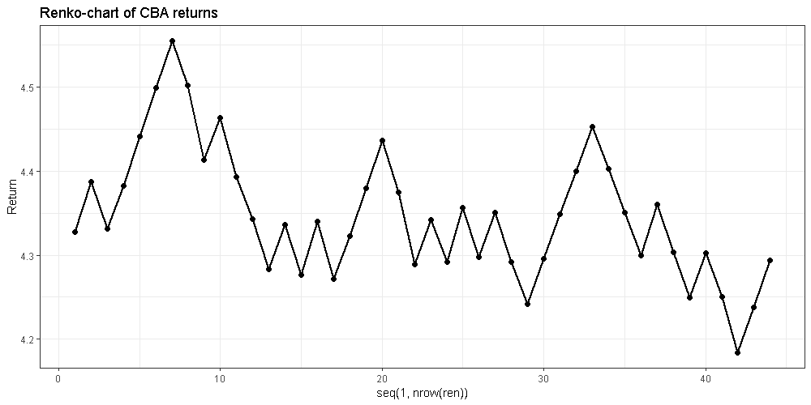
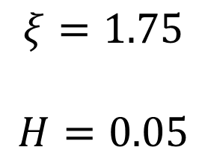
Stock market
get_xi <- function(pr){
temp <- sign(diff(pr))
temp <- sapply(seq(2, length(temp)),
function(i) temp[i-1] != temp[i])
return(1 / mean(temp))
}
get_xi(ren$Return)
$$ξ=1.75$$
$$H=0.05$$
$10,000 * 0.95^18 * 1.05^25 = $13,451 or 6.1% per year

Slide 42
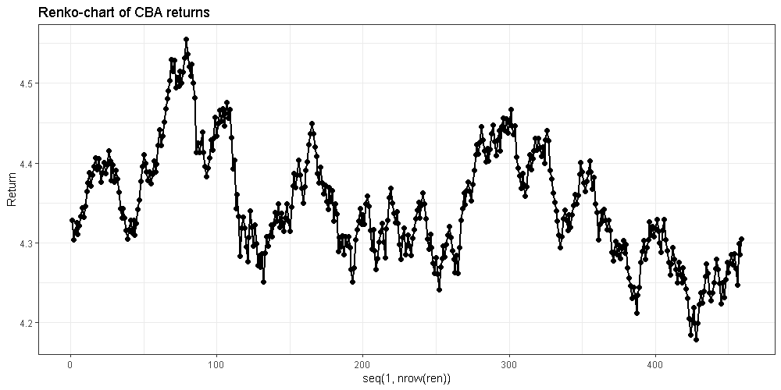
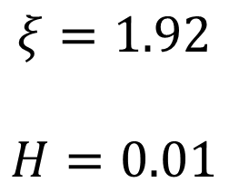
Stock market
get_xi <- function(pr){
temp <- sign(diff(pr))
temp <- sapply(seq(2, length(temp)),
function(i) temp[i-1] != temp[i])
return(1 / mean(temp))
}
get_xi(ren$Return)
$$ξ=1.92$$
$$H=0.01$$

Slide 43
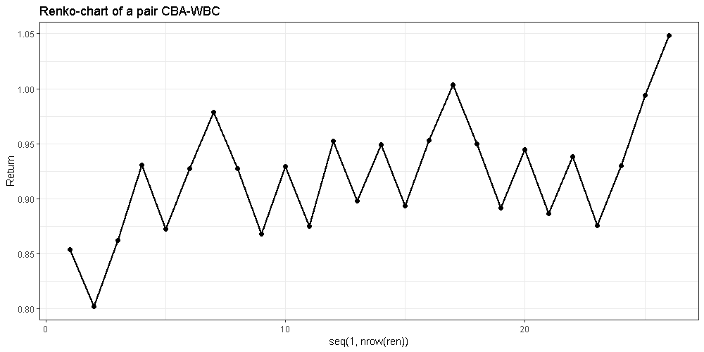
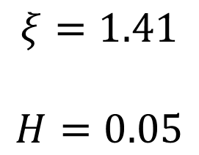
Stock market
$$ξ=1.41$$
$$H=0.05$$
$10,000 * 0.95^7 * 1.05^18 = $16,806 or 10.9% per year

Slide 44
References
ARMSTRONC, J. S. (1985). Long-Range Forecasting: From Cristal Ball to Computer (2nd Edn). New York: Wiley-Interscience. http://forecastingprinciples.com/index.php/books-journals-papers/text-trade-books?id=127
Yeh, P.F., 2006. Using prediction markets to enhance US intelligence capabilities. Studies in Intelligence, 50(4), pp.137-149. https://www.cia.gov/library/center-for-the-study-of-intelligence/csi-publications/csi-studies/studies/vol50no4/using-prediction-markets-to-enhance-us-intelligence-capabilities.html
Abramowicz, M., 2004. Information markets, administrative decision making, and predictive cost-benefit analysis. The University of Chicago Law Review, pp.933-1020.
Bogomolov, T., 2013. Pairs trading based on statistical variability of the spread process. Quantitative Finance, 13(9), pp.1411-1430.

Slide 45


Summary
Predictive analytics: subjective and objective
Subjective forecasting:
Aggregation of expert opinions, Delphi method, Information markets
Objective forecasting: naive and causal
Time series - naive forecasting
Random Walk - impossible to make predictions
Time series transformation and filtering
Don’t Gamble! …unless you understand the process in details and probability is on your side.

Slide 46
Thank you

